Slide 1

Intro
Notes:
textbox
No alt text provided
textbox
No alt text provided
image
No alt text provided
textbox
No alt text provided

Slide 2
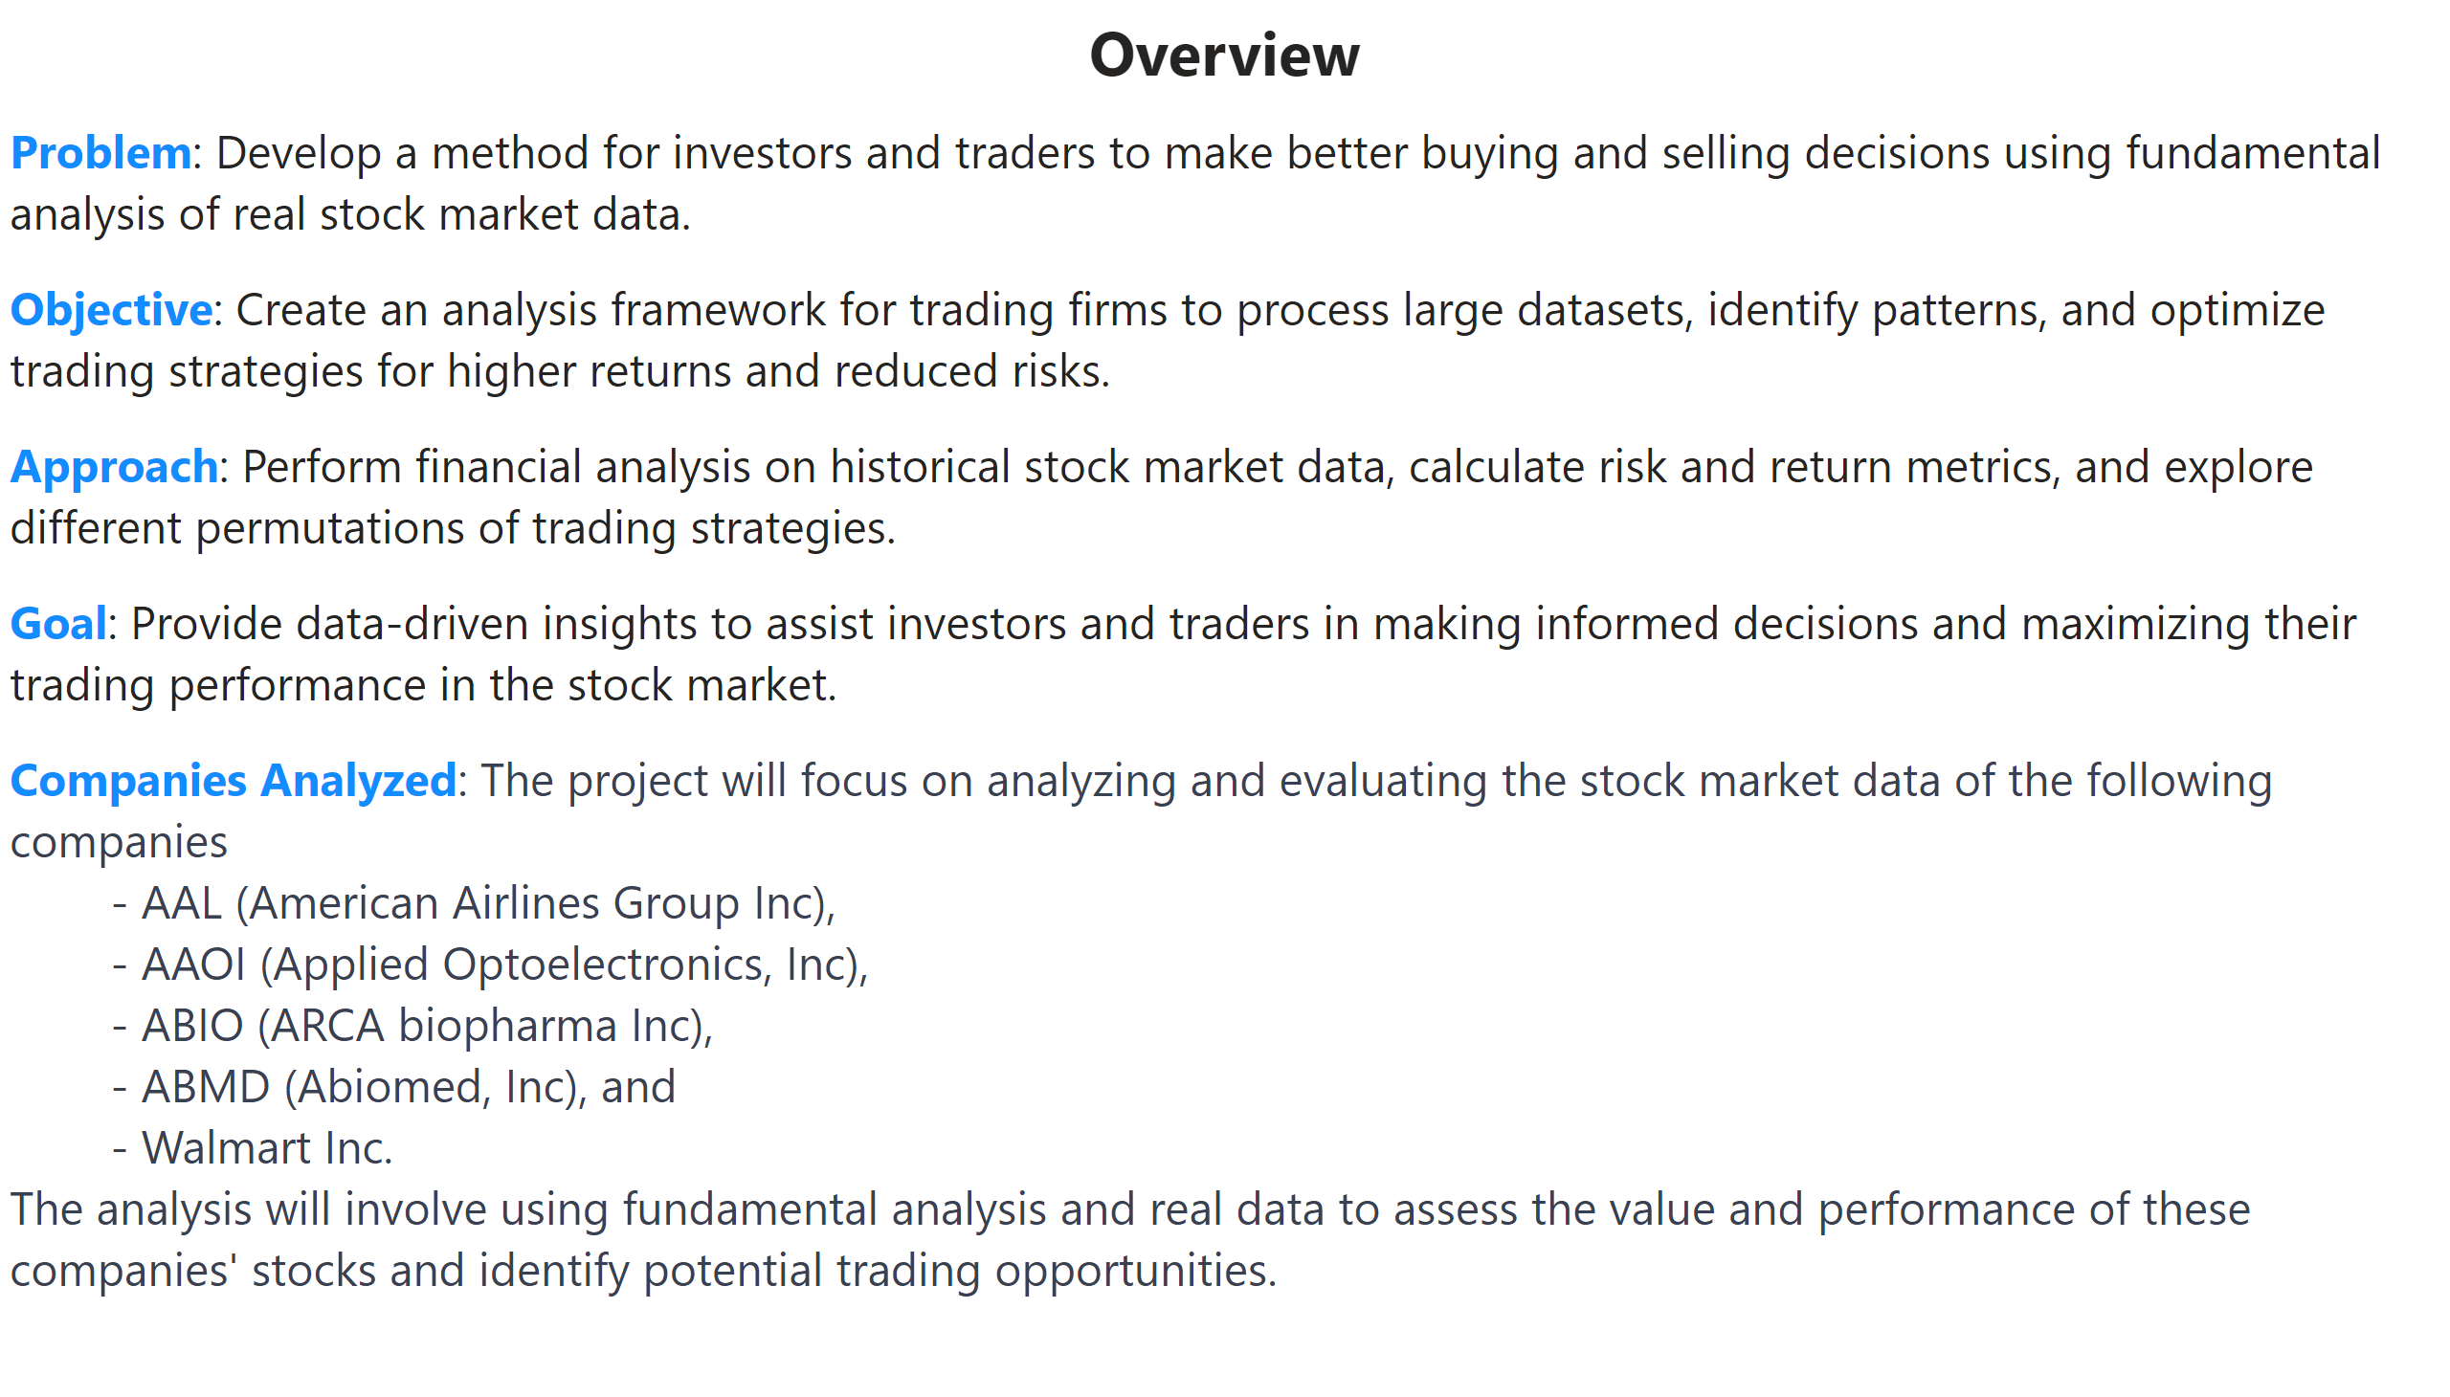
E1
Notes:
textbox
No alt text provided
textbox
No alt text provided

Slide 3
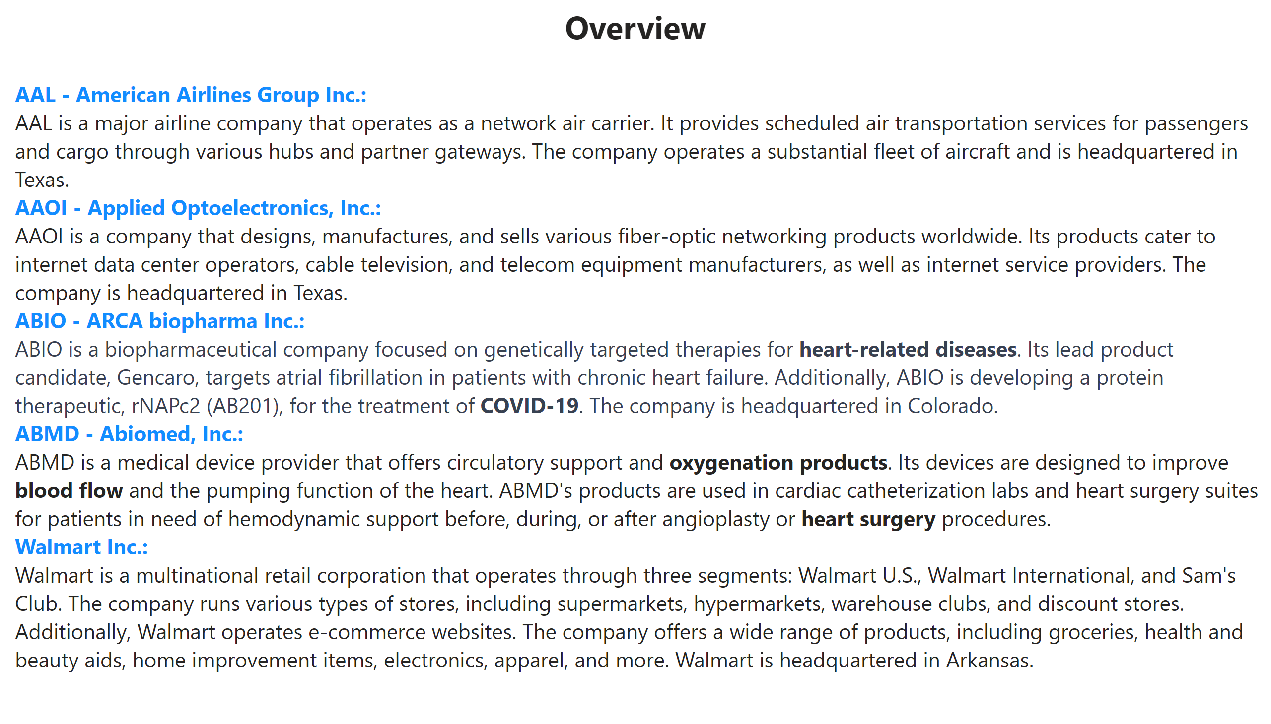
E2
Notes:
textbox
No alt text provided
textbox
No alt text provided

Slide 4
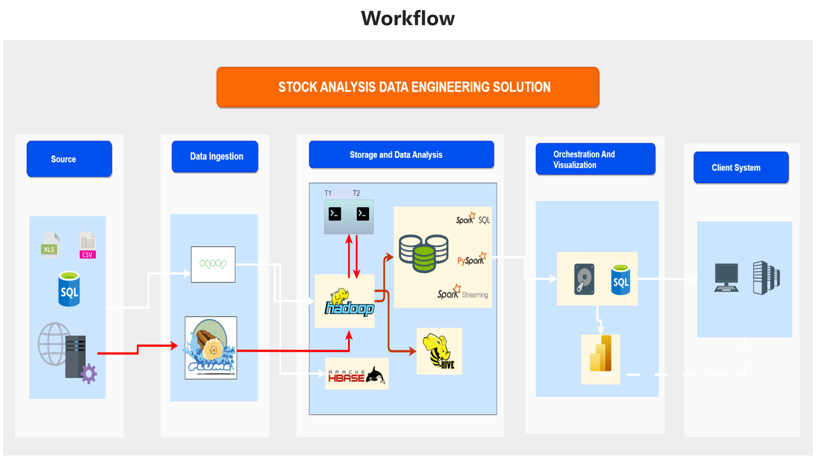
E3
Notes:
textbox
No alt text provided
image
No alt text provided

Slide 5
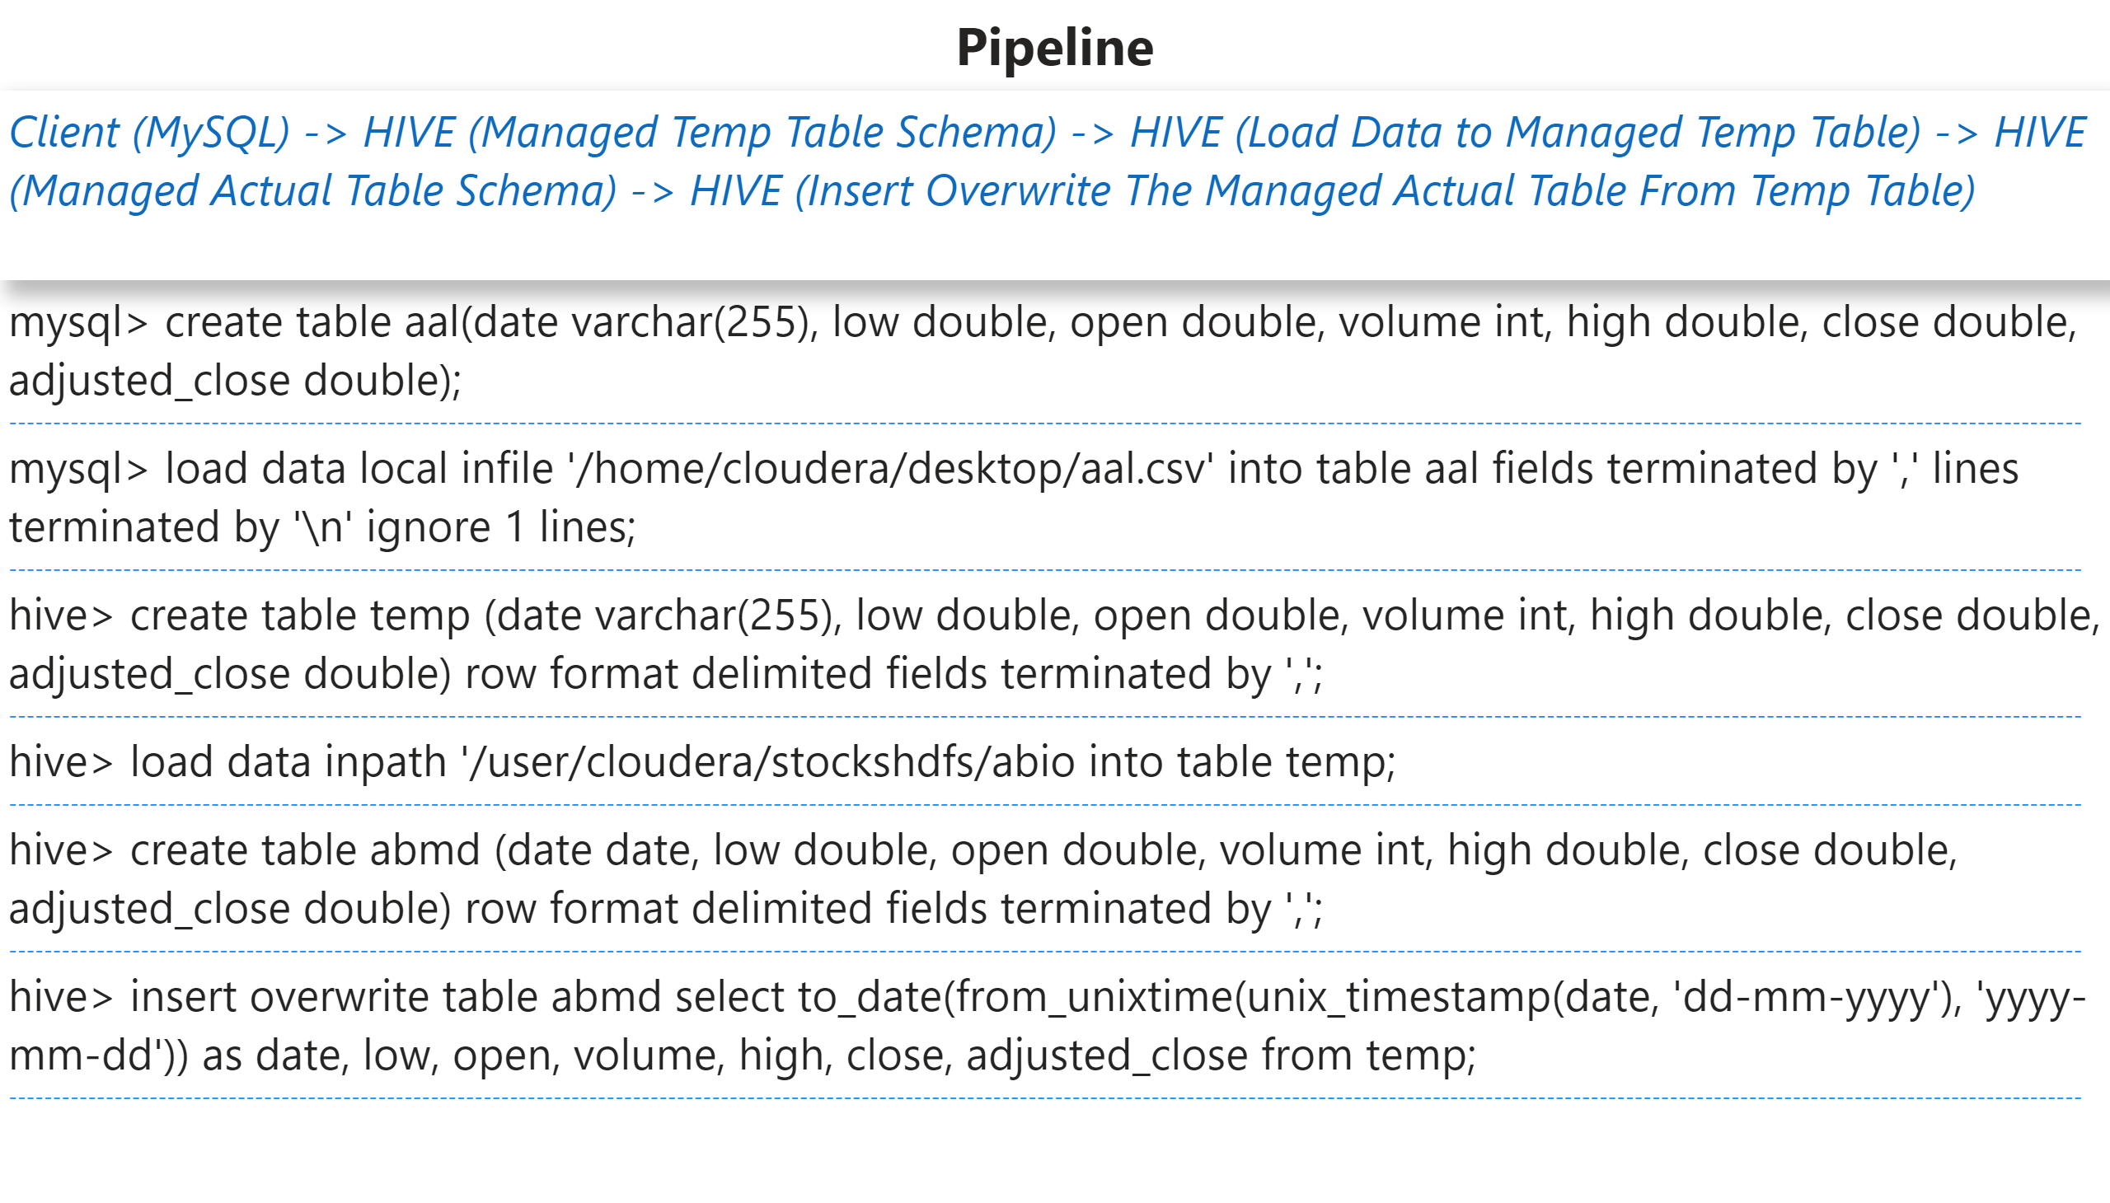
E4
Notes:
textbox
No alt text provided
textbox
No alt text provided
textbox
No alt text provided

Slide 6
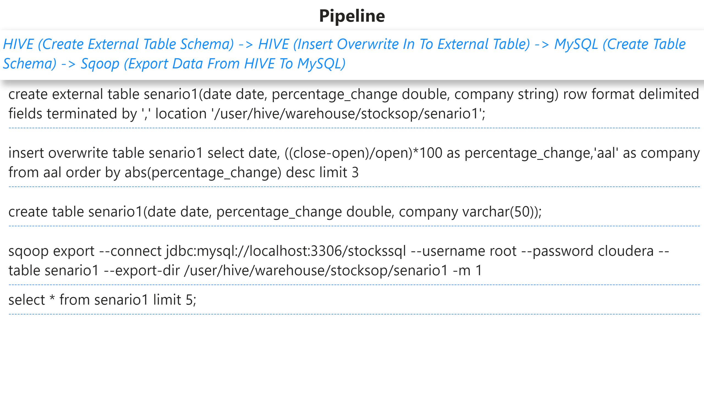
E5
Notes:
textbox
No alt text provided
textbox
No alt text provided
textbox
No alt text provided

Slide 7
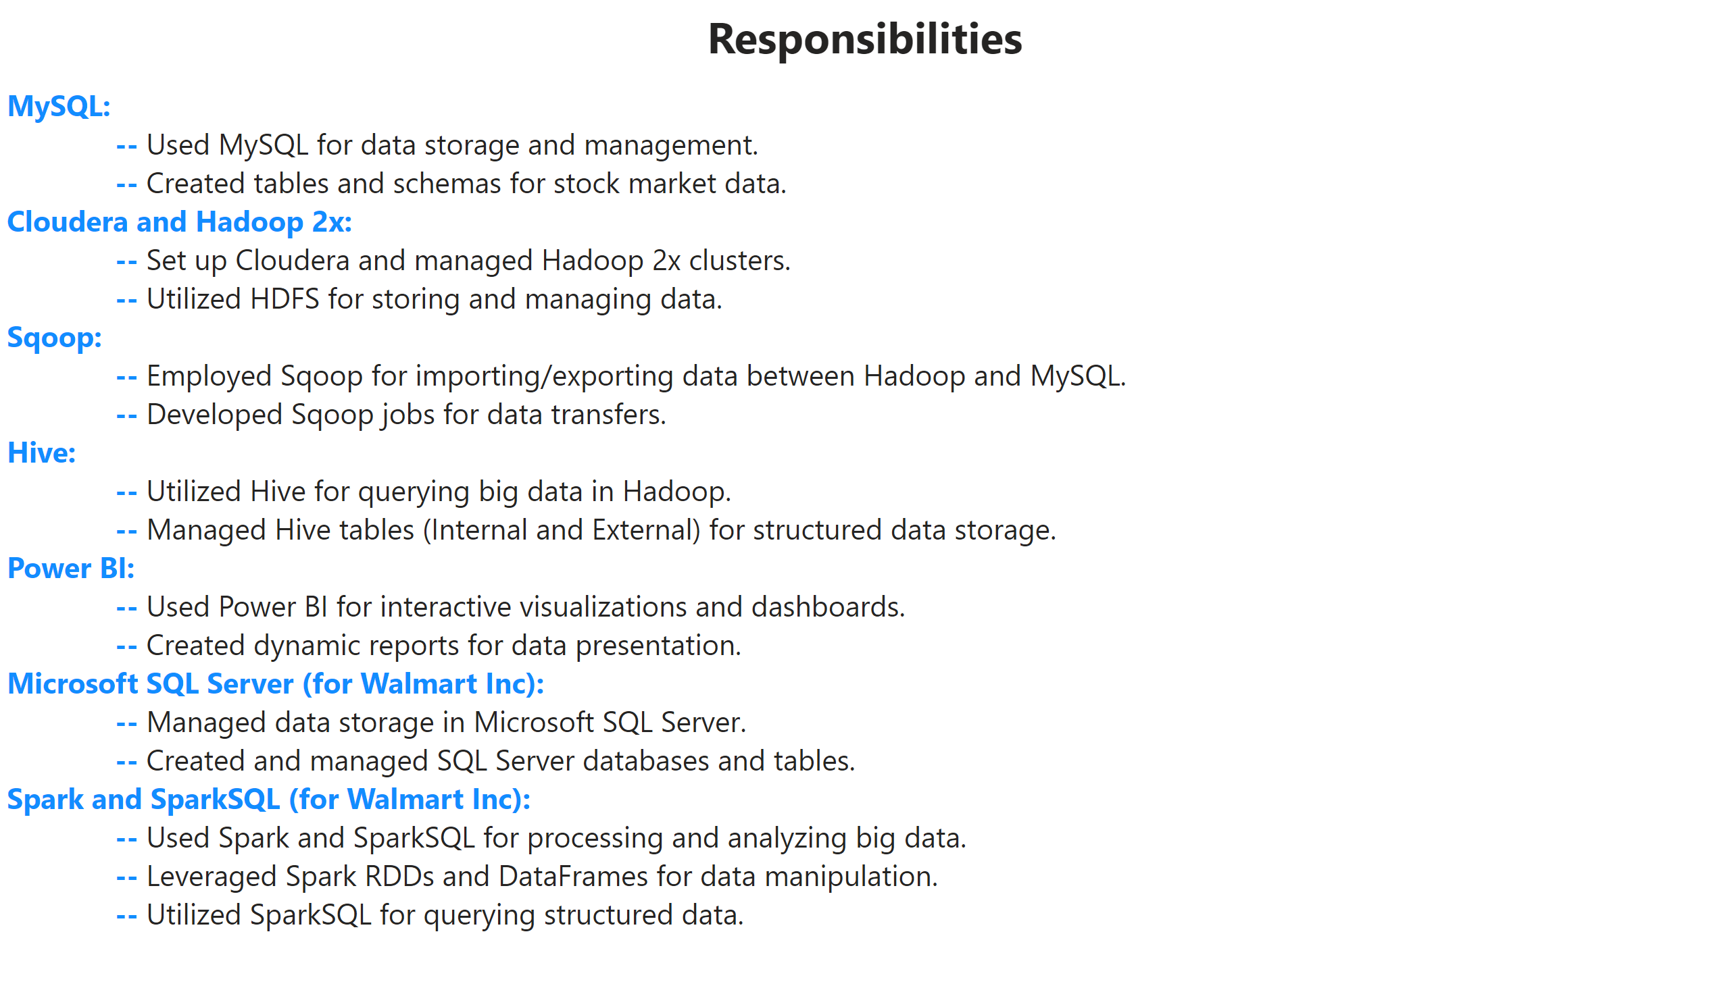
E6
Notes:
textbox
No alt text provided
textbox
No alt text provided

Slide 8
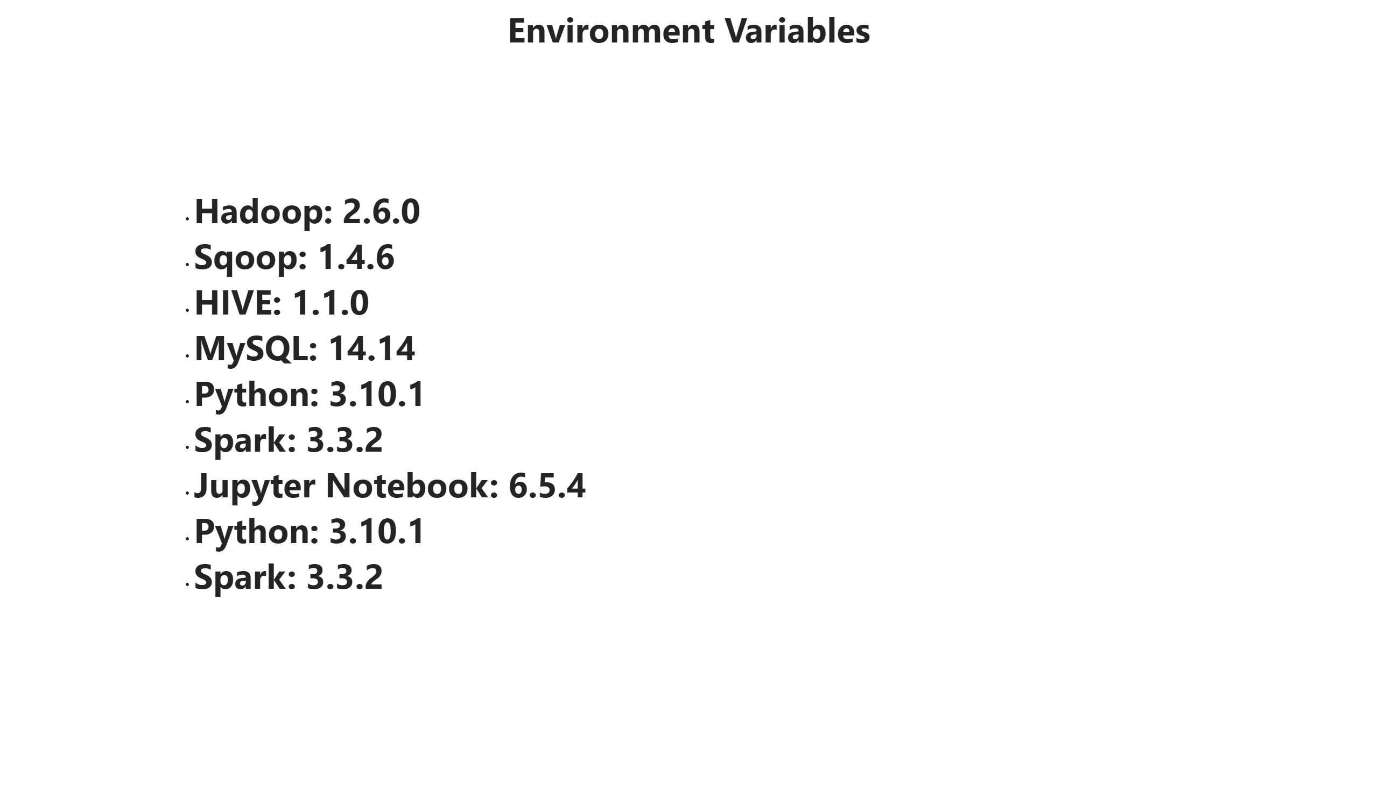
E7
Notes:
textbox
No alt text provided
textbox
No alt text provided

Slide 9
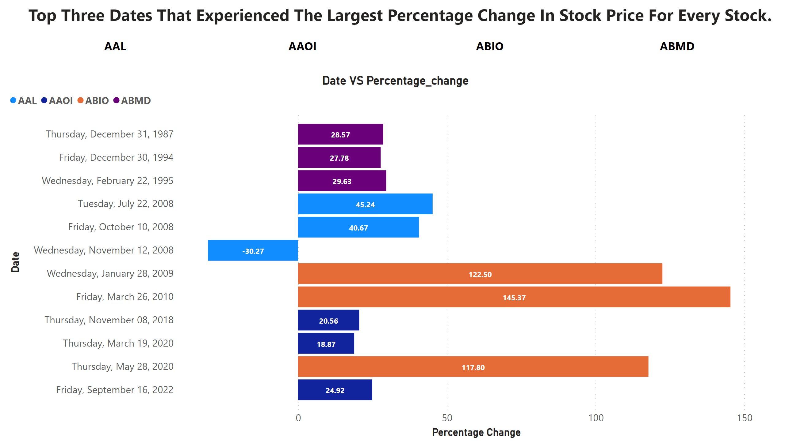
1
Notes:
textbox
No alt text provided
Date VS Percentage_change
No alt text provided
slicer
No alt text provided

Slide 10
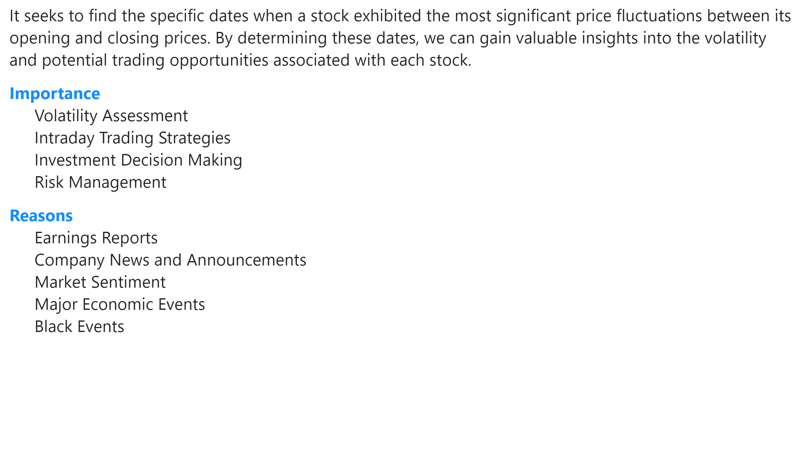
Page 1
Notes:
textbox
No alt text provided

Slide 11
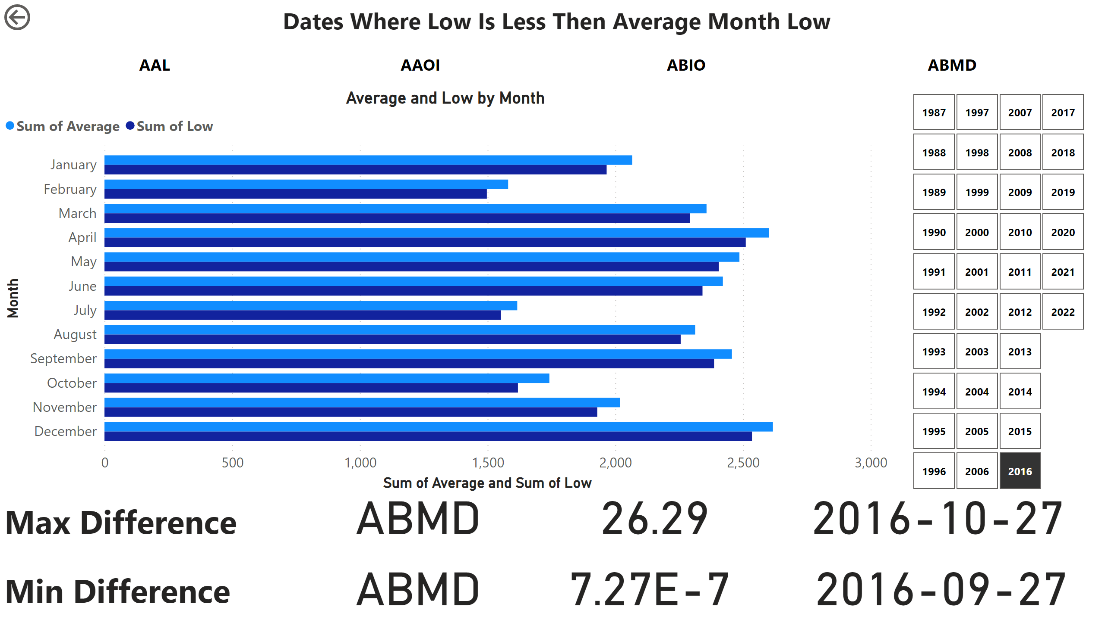
2
Notes:
textbox
No alt text provided
Average and Low by Month
No alt text provided
actionButton
No alt text provided
slicer
No alt text provided
slicer
No alt text provided
card
No alt text provided
card
No alt text provided
card
No alt text provided
card
No alt text provided
textbox
No alt text provided
textbox
No alt text provided
card
No alt text provided
card
No alt text provided

Slide 12
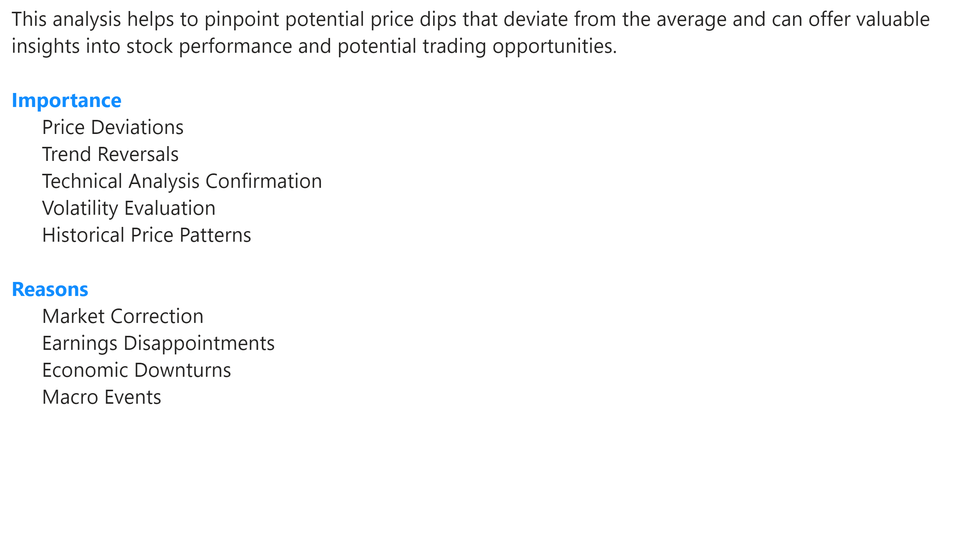
Page 2
Notes:
textbox
No alt text provided

Slide 13
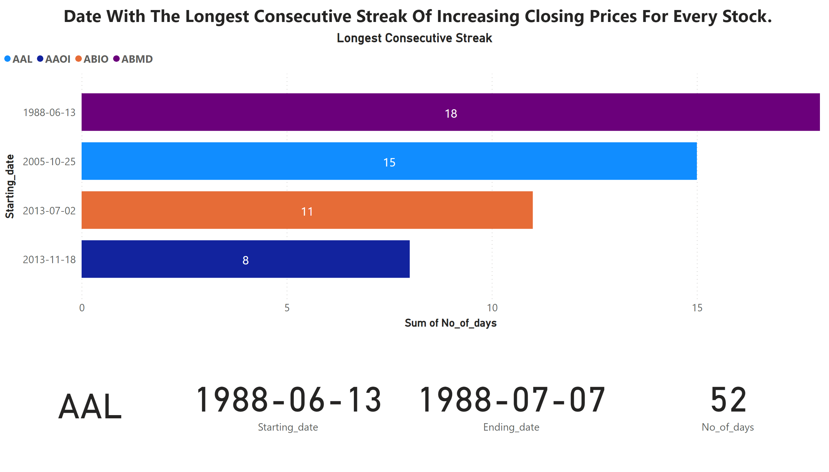
3
Notes:
textbox
No alt text provided
Longest Consecutive Streak
No alt text provided
card
No alt text provided
card
No alt text provided
card
No alt text provided
card
No alt text provided

Slide 14
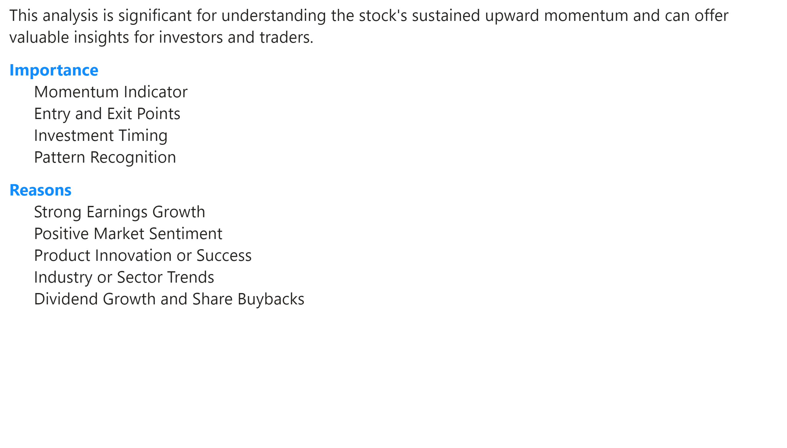
Page 3
Notes:
textbox
No alt text provided

Slide 15
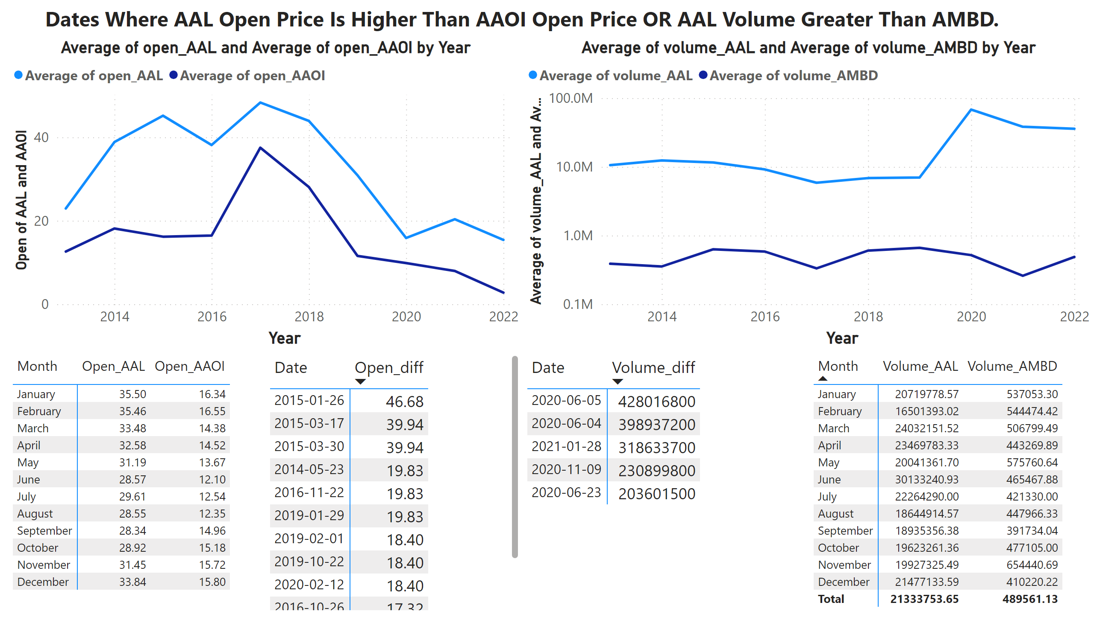
4
Notes:
textbox
No alt text provided
lineChart
No alt text provided
lineChart
No alt text provided
pivotTable
No alt text provided
pivotTable
No alt text provided
pivotTable
No alt text provided
pivotTable
No alt text provided

Slide 16
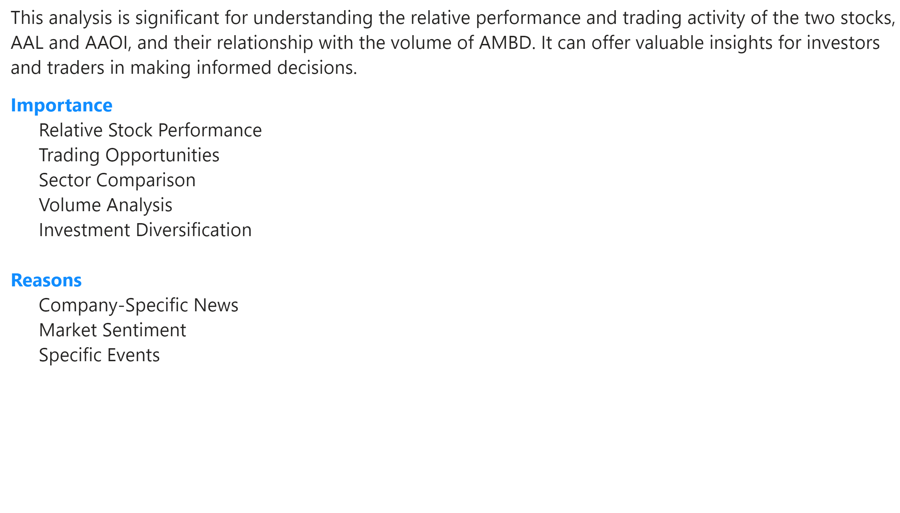
Page 4
Notes:
textbox
No alt text provided

Slide 17
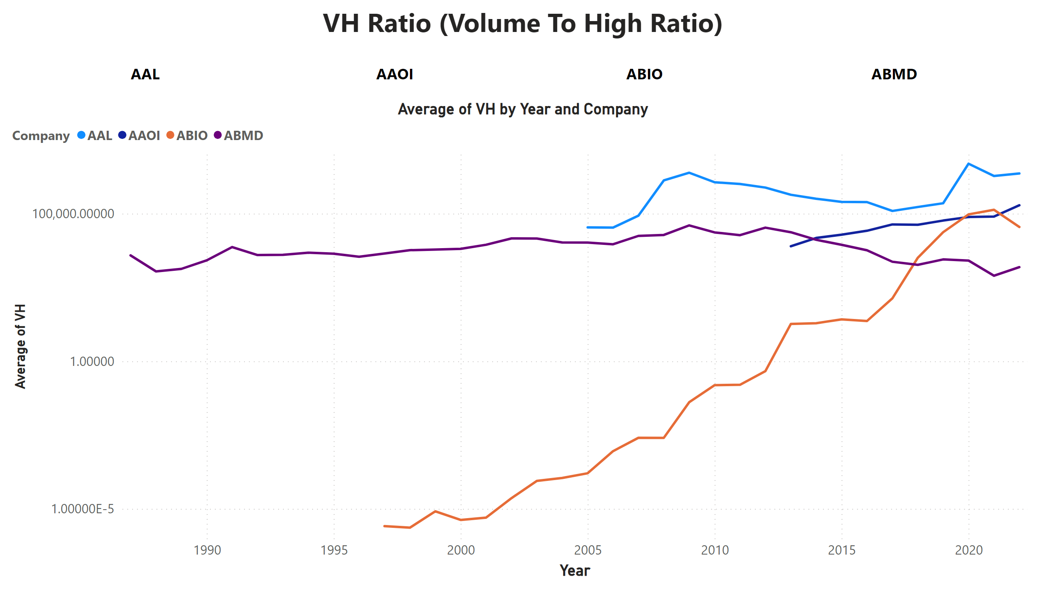
5
Notes:
textbox
No alt text provided
lineChart
No alt text provided
slicer
No alt text provided

Slide 18
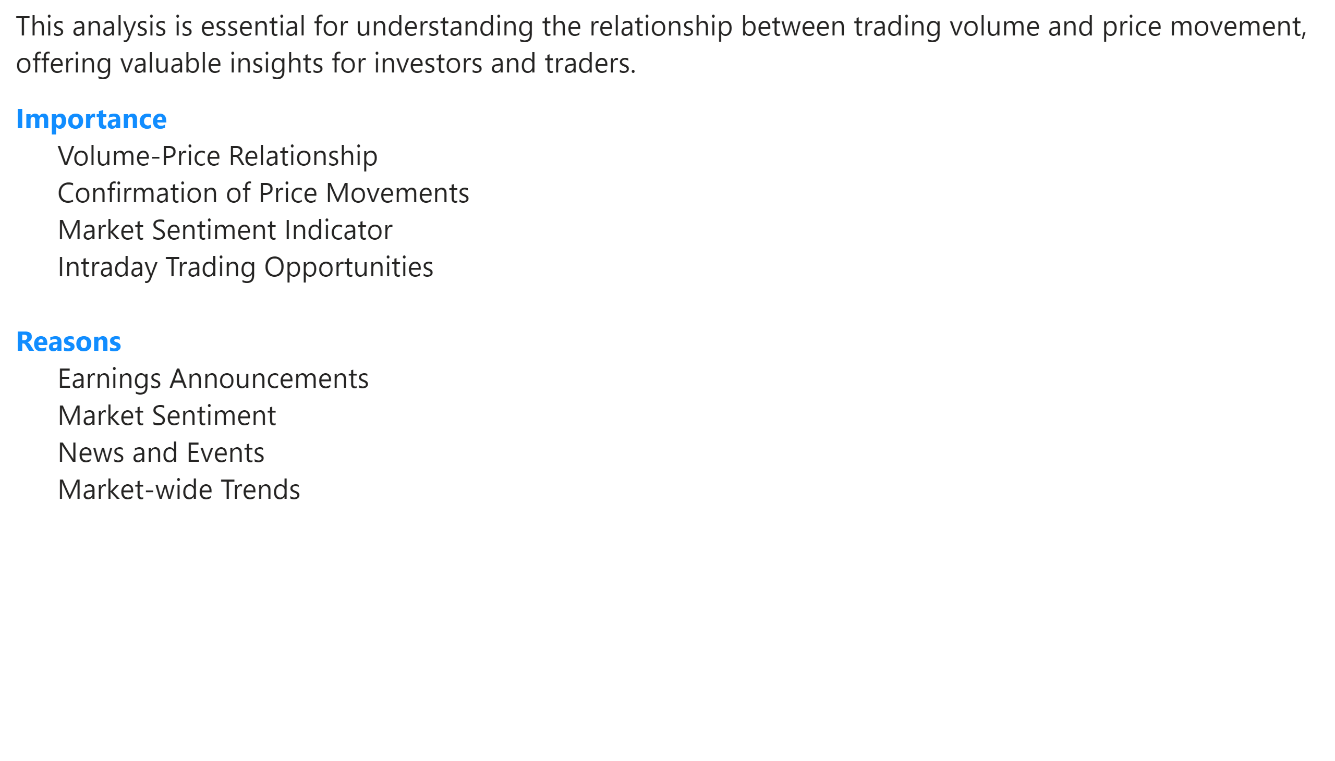
Page 5
Notes:
textbox
No alt text provided

Slide 19
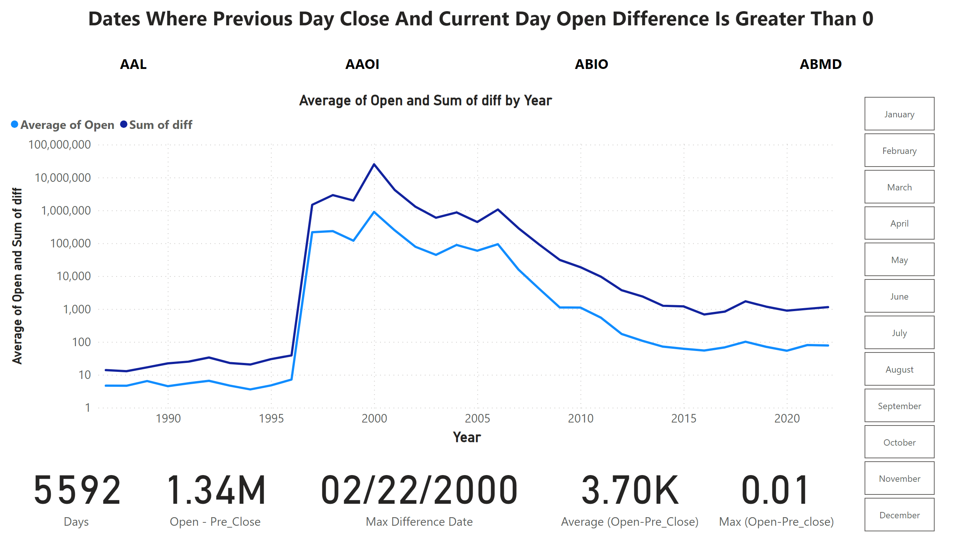
6
Notes:
textbox
No alt text provided
lineChart
No alt text provided
card
No alt text provided
card
No alt text provided
slicer
No alt text provided
card
No alt text provided
slicer
No alt text provided
card
No alt text provided
card
No alt text provided

Slide 20
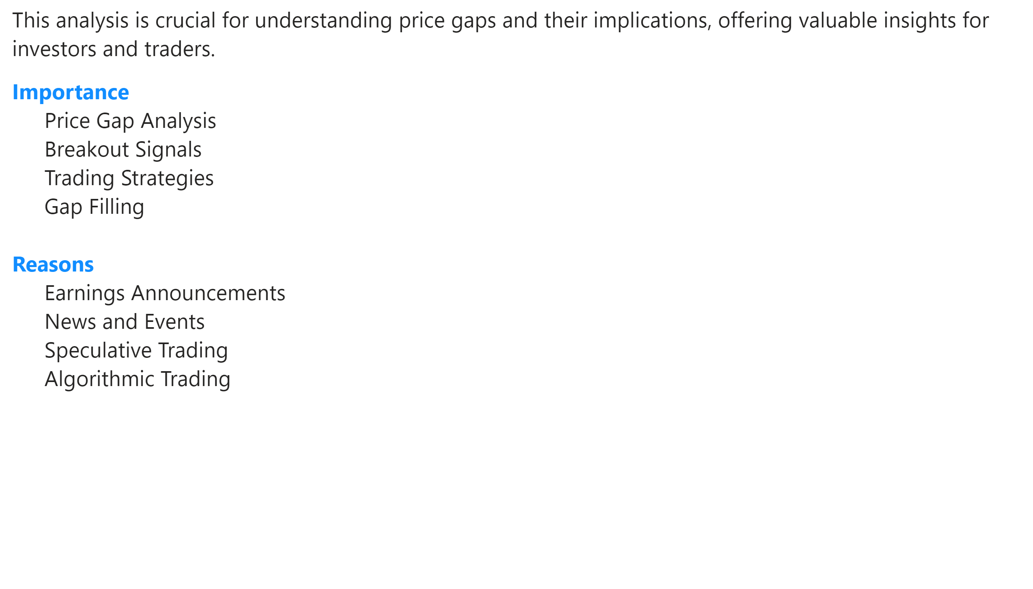
Page 6
Notes:
textbox
No alt text provided

Slide 21
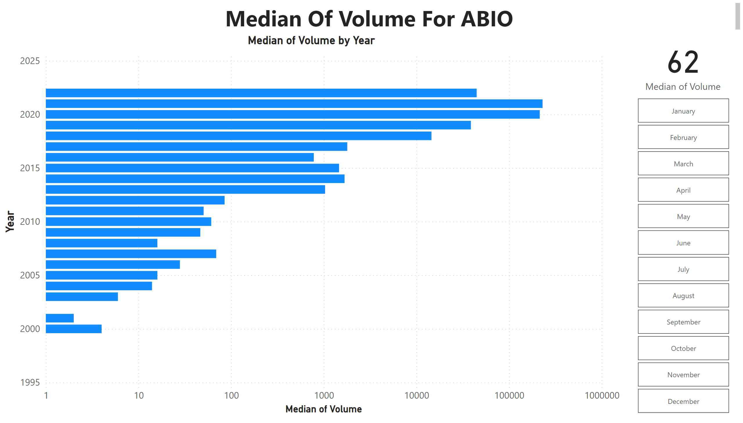
7
Notes:
textbox
No alt text provided
barChart
No alt text provided
slicer
No alt text provided
card
No alt text provided

Slide 22
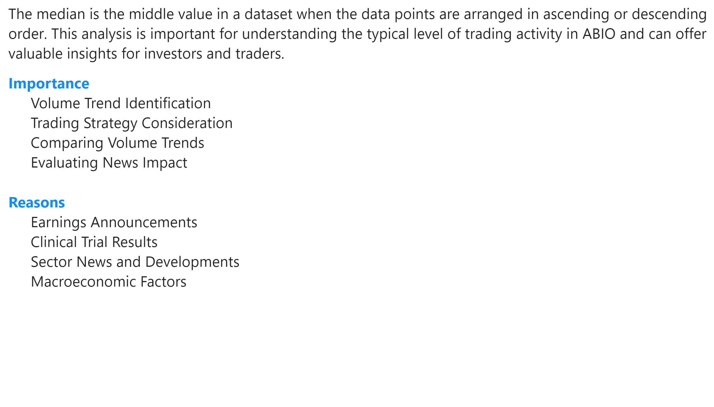
Page 7
Notes:
textbox
No alt text provided

Slide 23
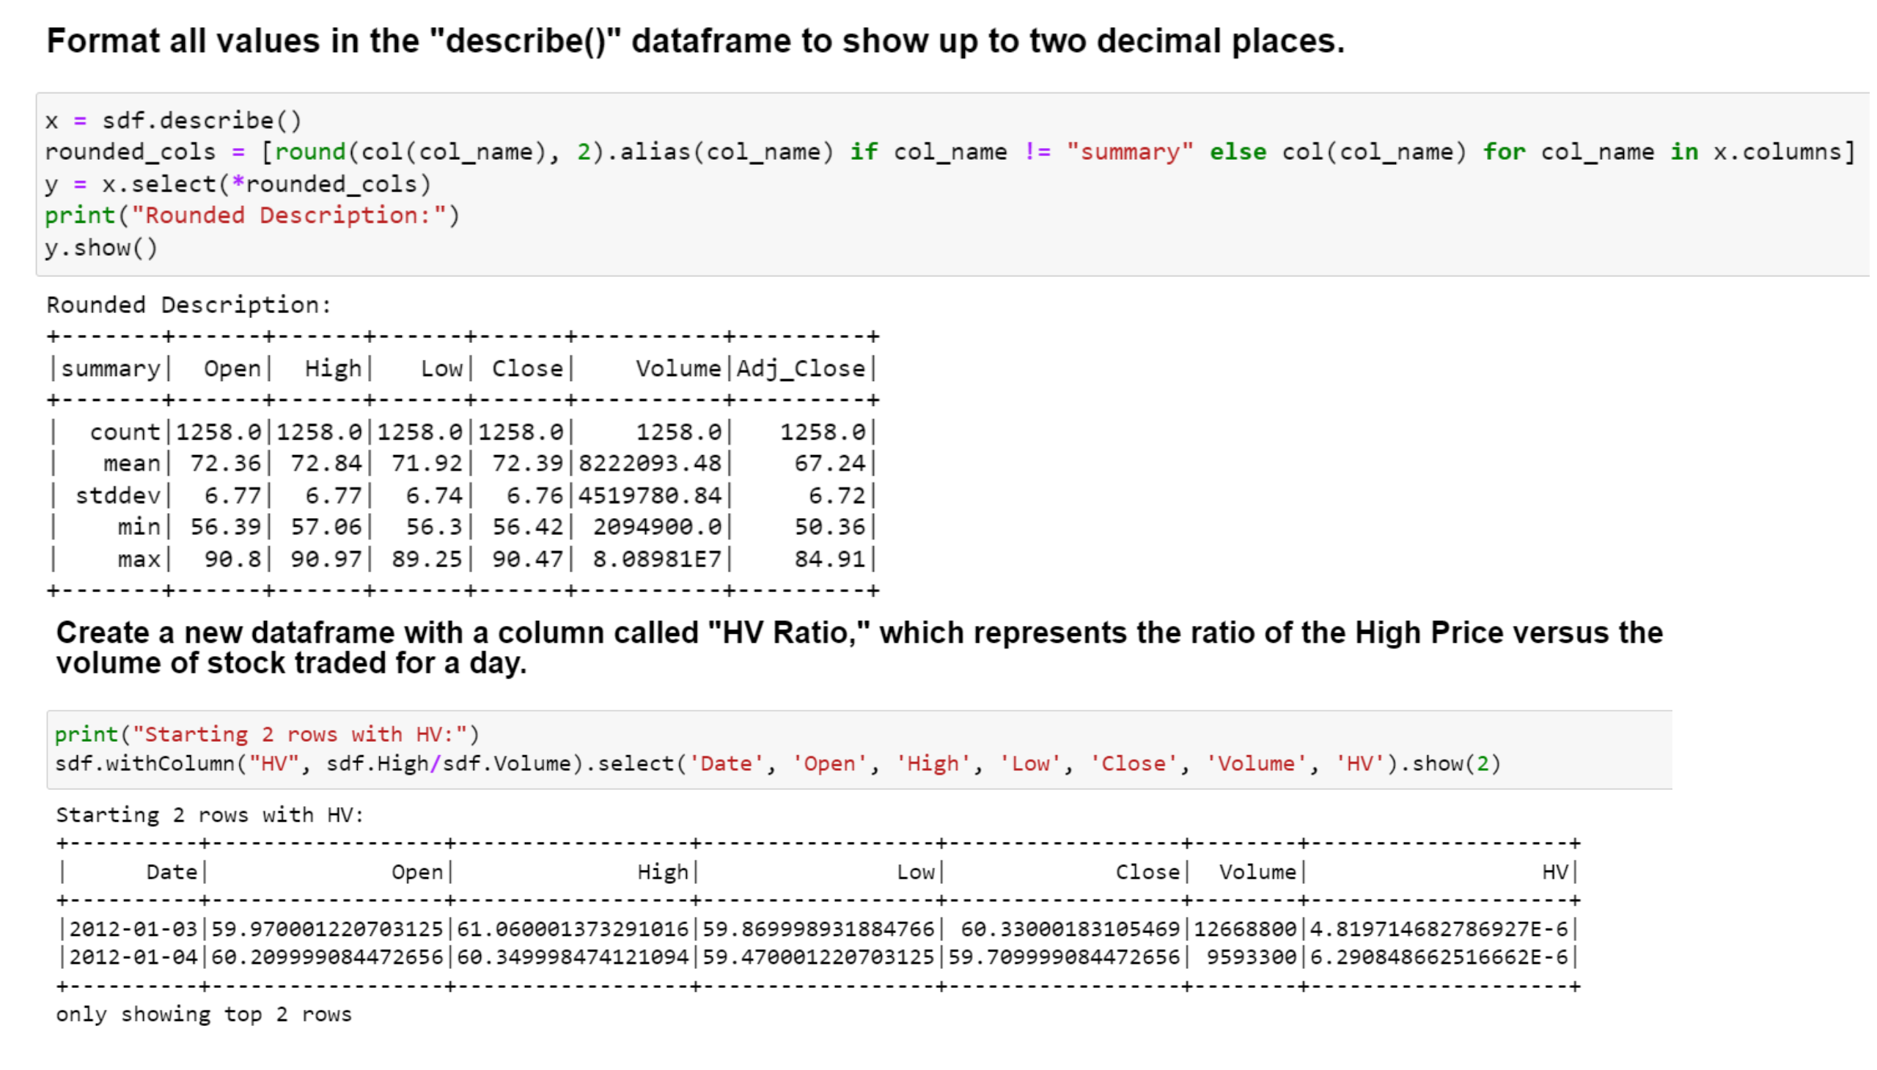
W1
Notes:
image
No alt text provided
image
No alt text provided

Slide 24
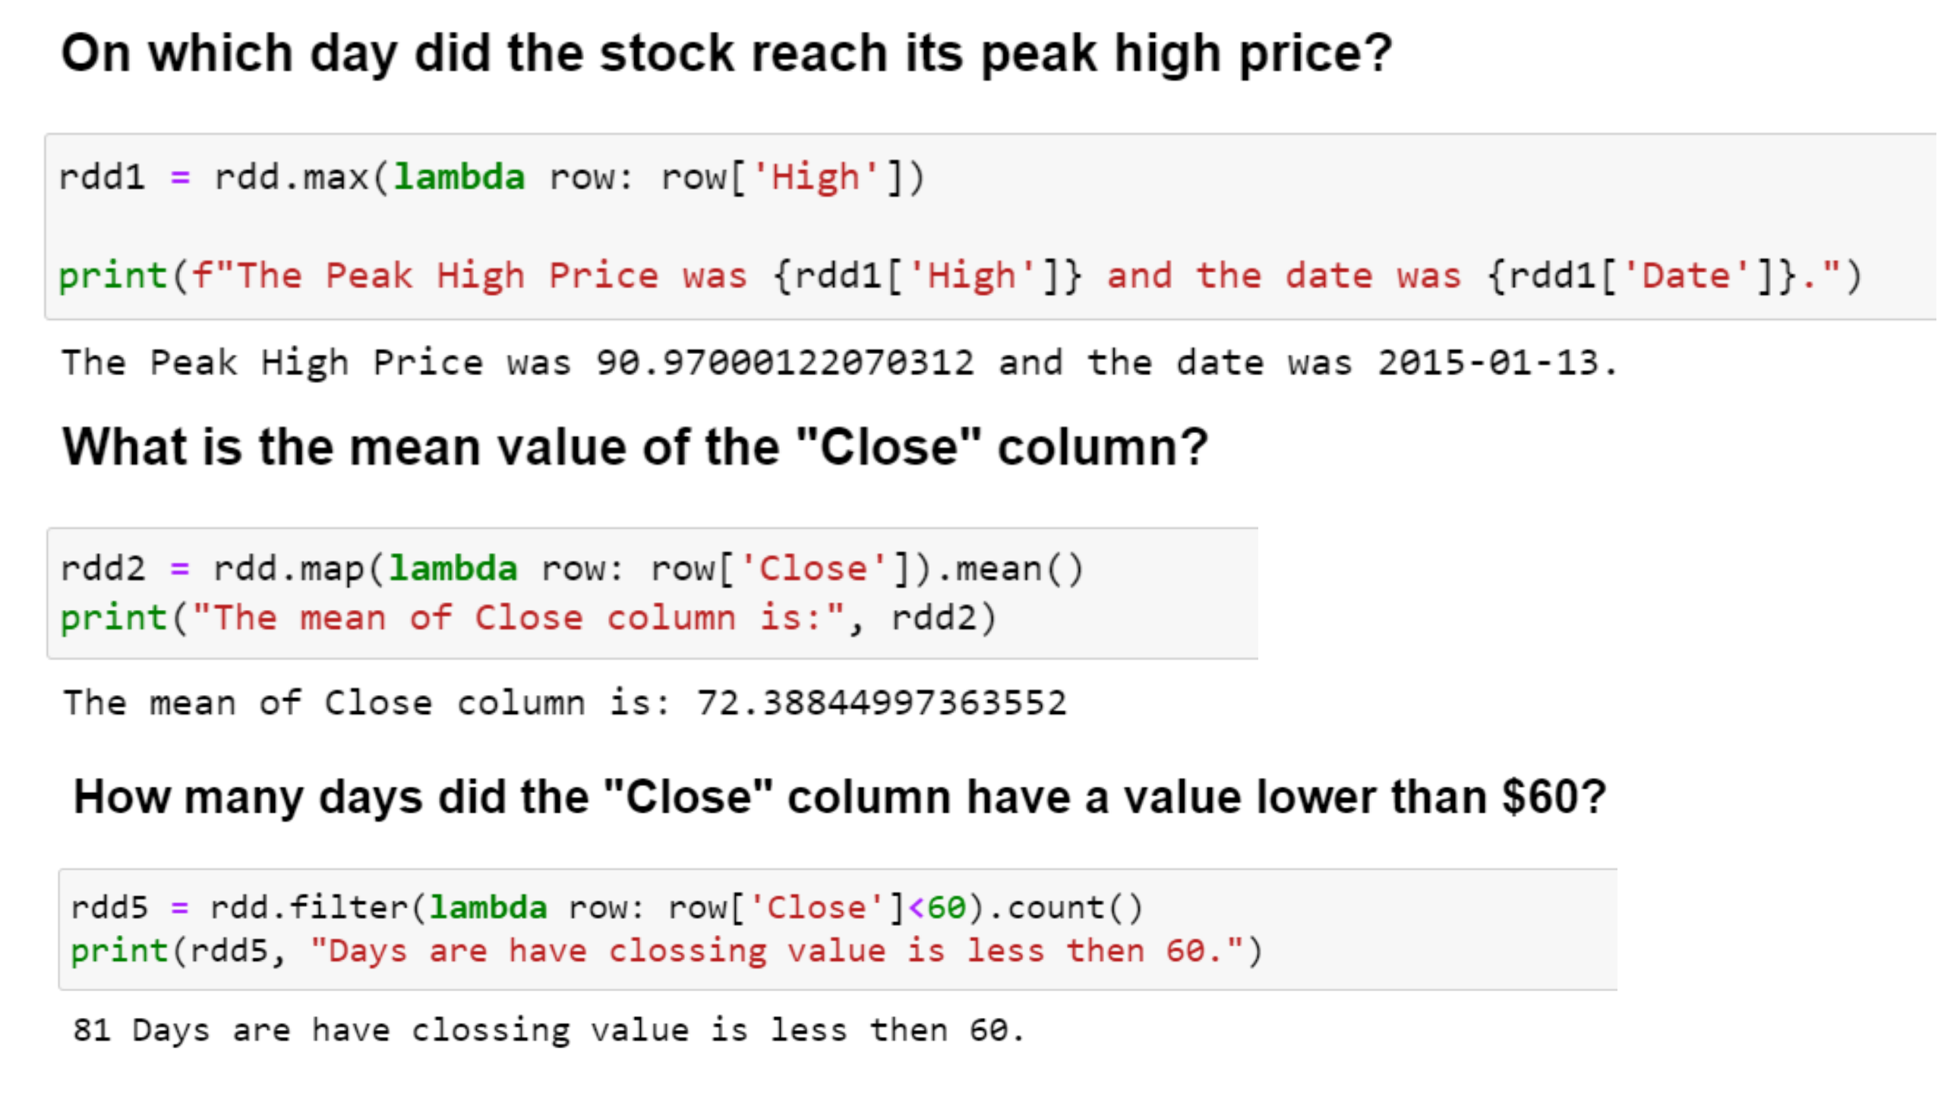
W2
Notes:
image
No alt text provided
image
No alt text provided
image
No alt text provided

Slide 25
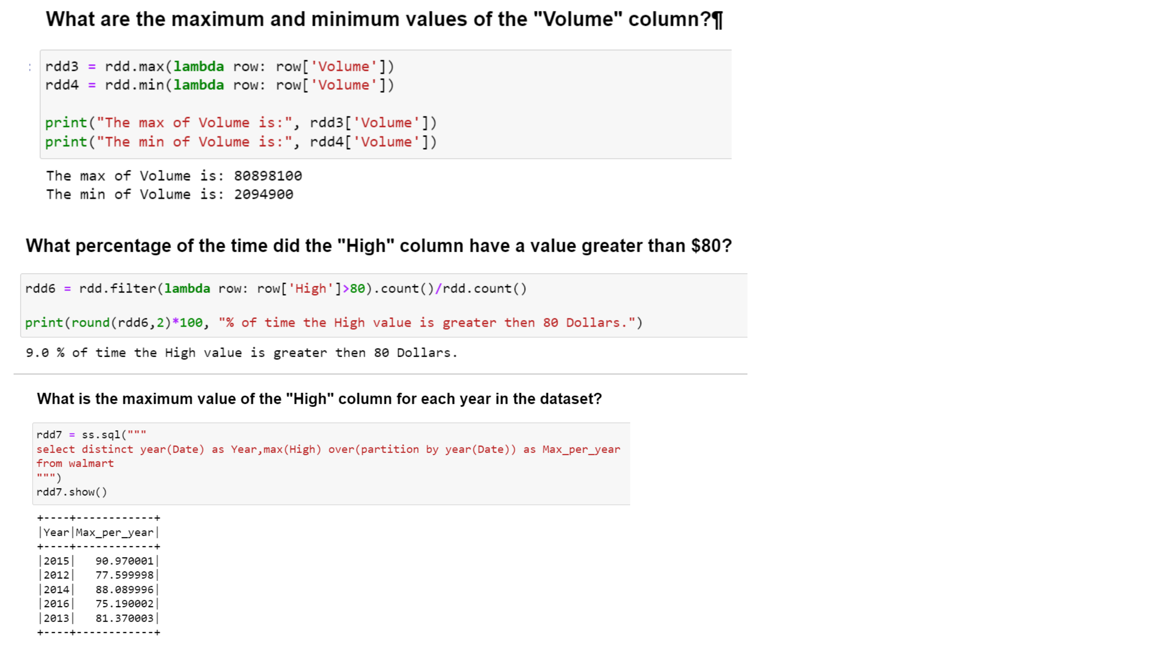
W3
Notes:
image
No alt text provided
image
No alt text provided
image
No alt text provided

Slide 26

Page 8
Notes:
textbox
No alt text provided

